Slide 1
OBJECTIVES
Design and development of a BMS module using BQ76952 IC for a 24V 6Ah LiFePO4 (Lithium Iron Phosphate ) Battery Pack.
Real-time monitoring of battery parameters using an STM32F103CBT6 microcontroller, with data displayed on an LCD screen.

Slide 2
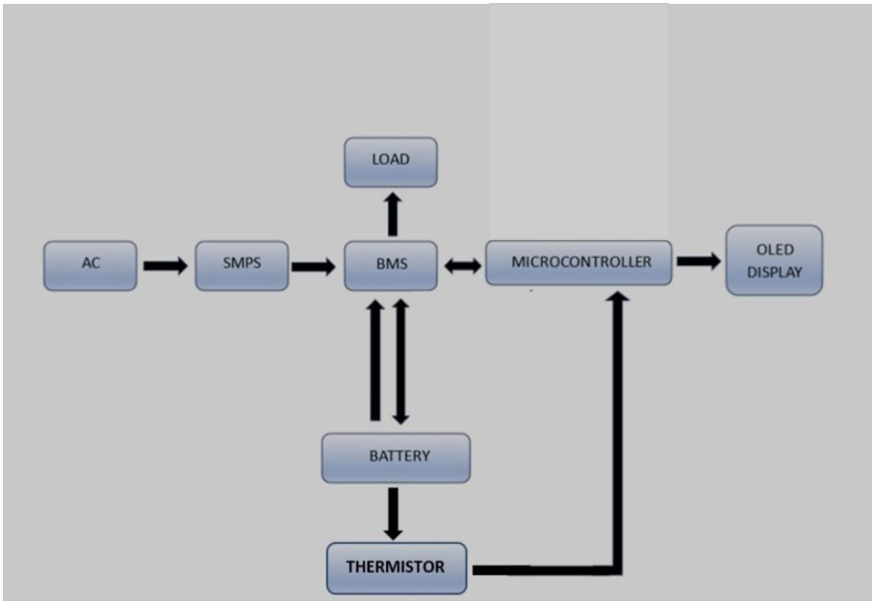


BLOCK DIAGRAM
LOAD
SMPS
LCD DISPLAY
AC
BMS
MICROCONTROLLER
BATTERY
THERMISTOR

Slide 3
RELEVENCE
Growing Demand for Energy Storage
Battery Safety & Protection
Maximizing Battery Life
Environmental Impact

Slide 4
WORKFLOW
PHASE-1 : Literature Survey & Preliminary works
PHASE-2 : Schematic and PCB development
PHASE-3 : Microcontroller coding and debugging
PHASE-4 : Evaluation, correcting errors, Documentation and reporting

Slide 5

SCHEMATIC

Slide 6
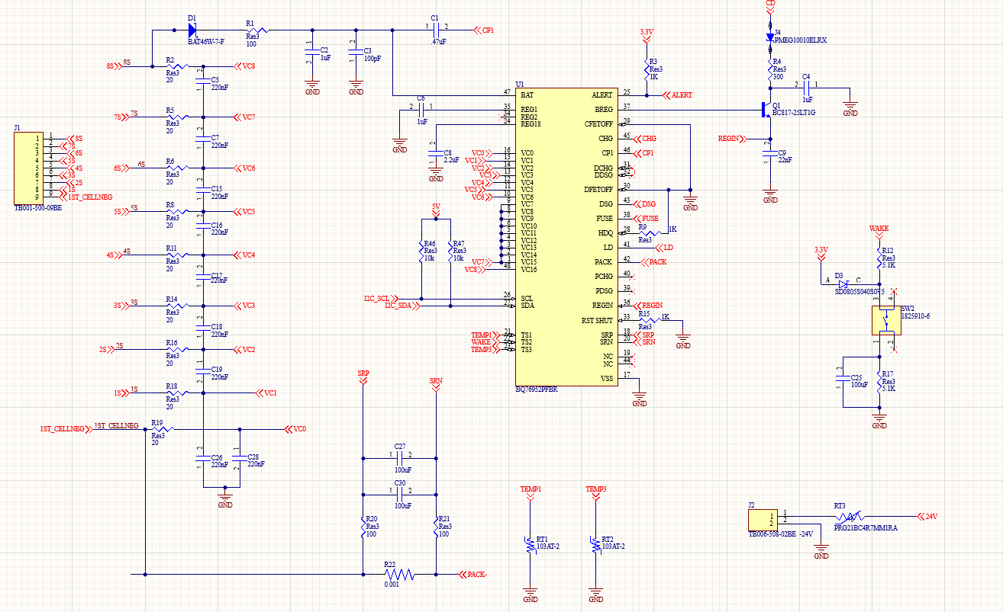

Slide 7
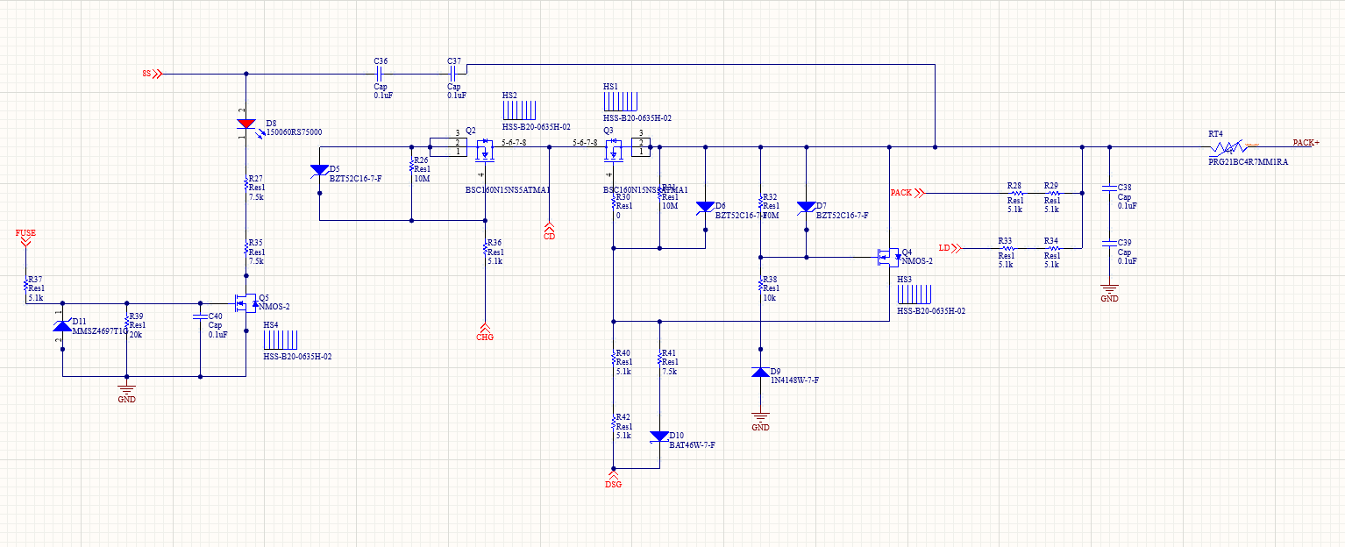

Slide 8
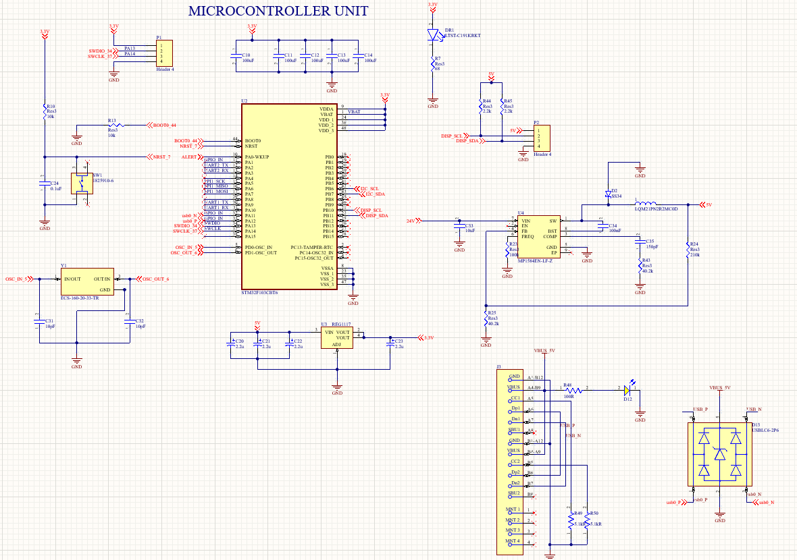

Slide 9
PCB 3D VIEW

Slide 10
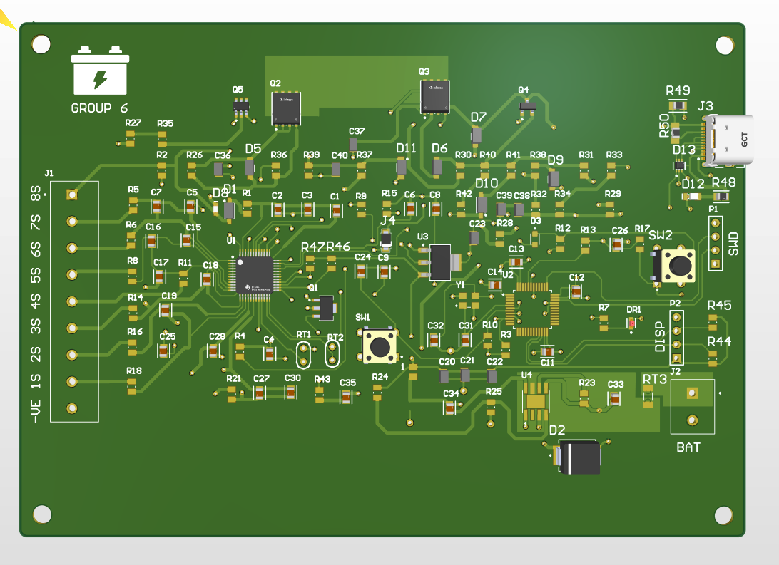

Slide 11
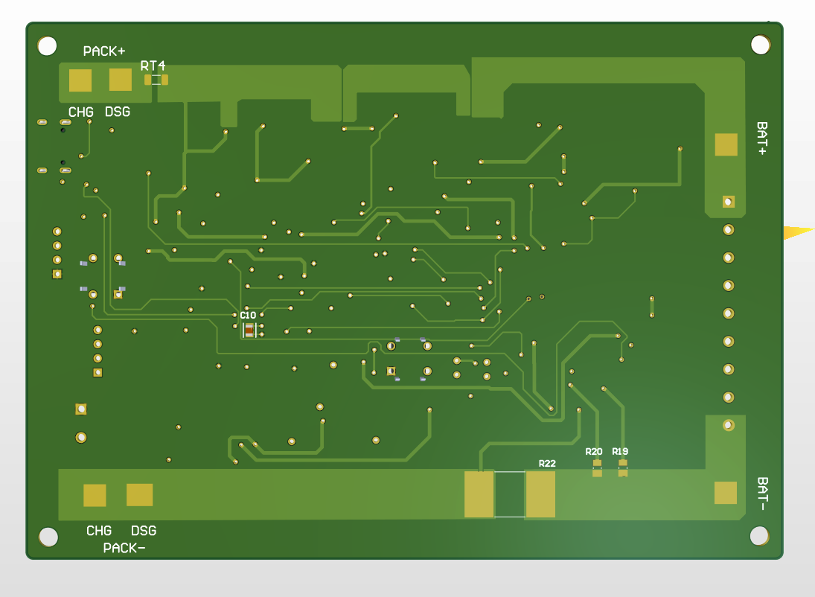

Slide 12
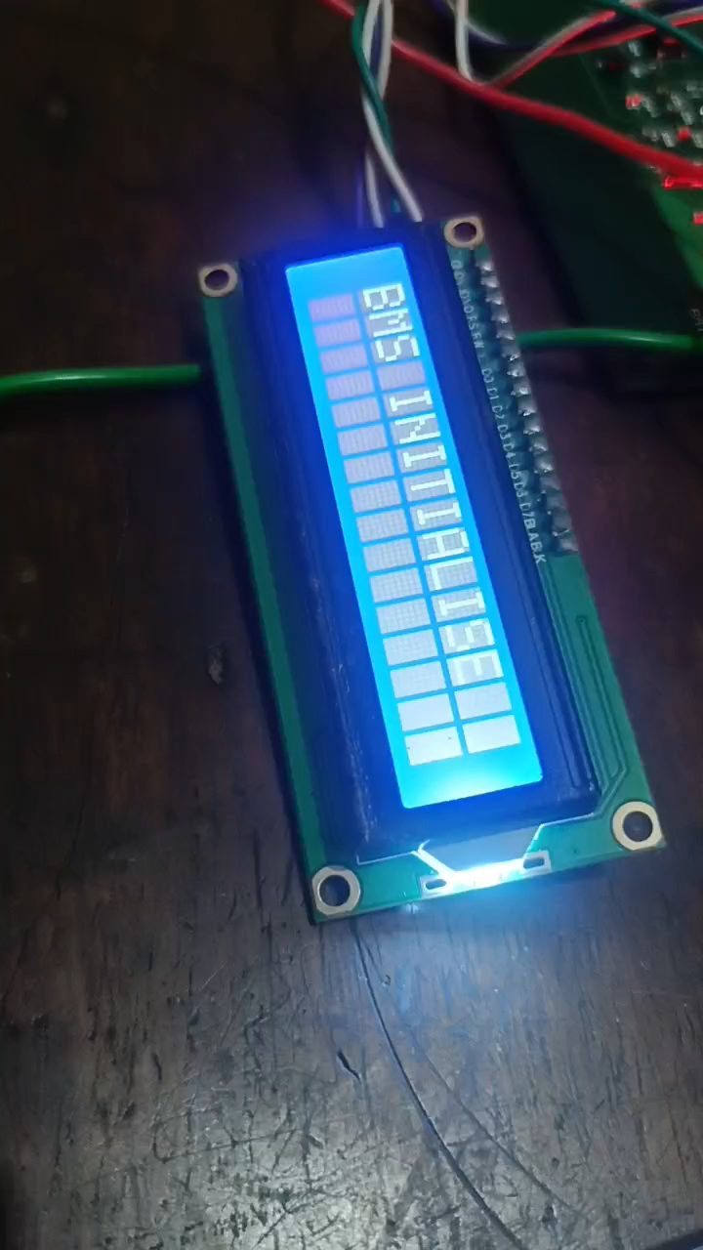
DEMONSTRATION

Slide 13
THANK YOU

